Slide 1
Automatically creating Presentations with GPT-3
Thomas, Maria, Ralf, Patrick
https://github.com/PatrickSinger99/GPT3PowerPoint

Slide 2
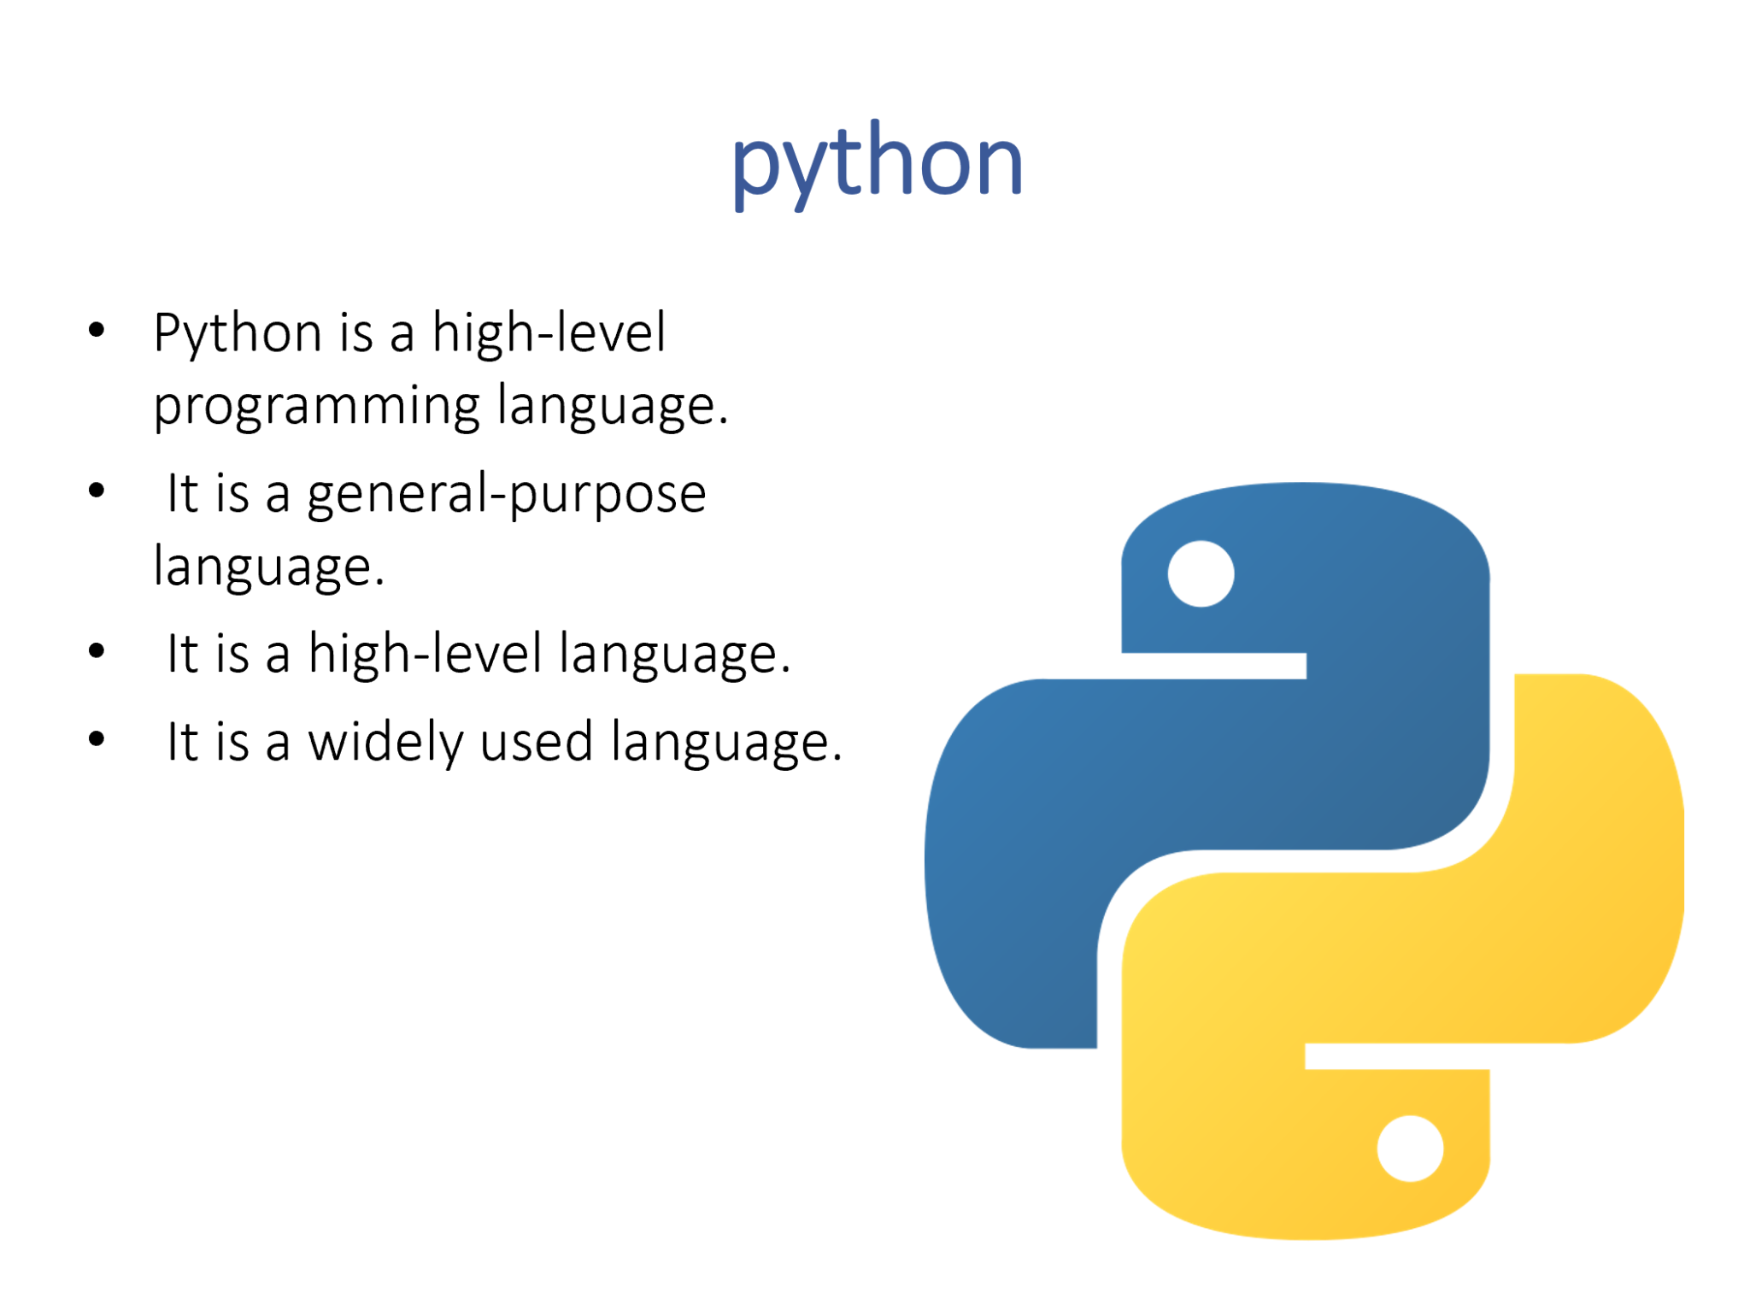
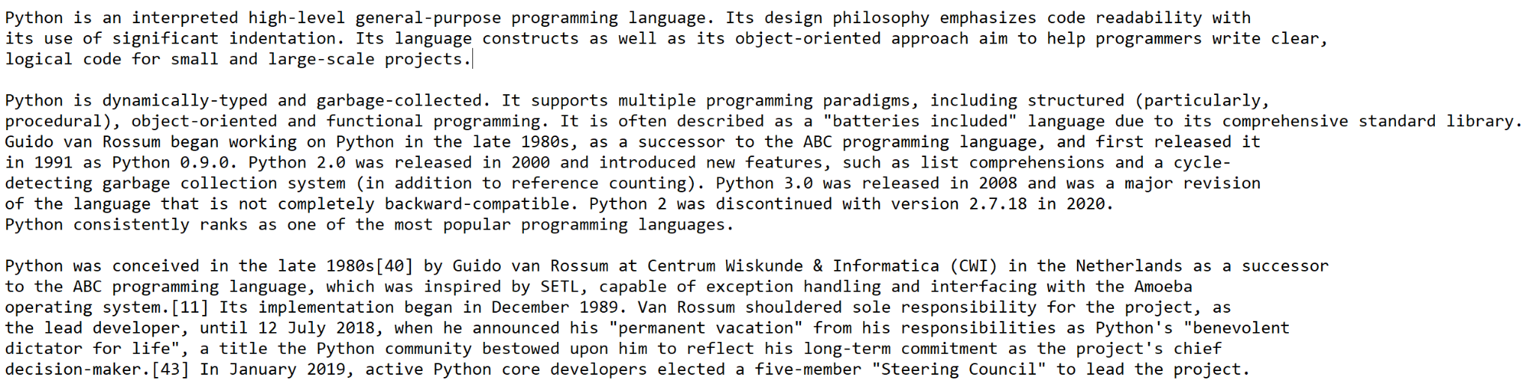
Version 1: One slide PowerPoint file
Text is used as input
A GPT-3 model was trained to generate bullet points from the text
A second model used the text as input to generate a keyword. The keyword is used as the slide title and to download a picture
Output
Input

Slide 3
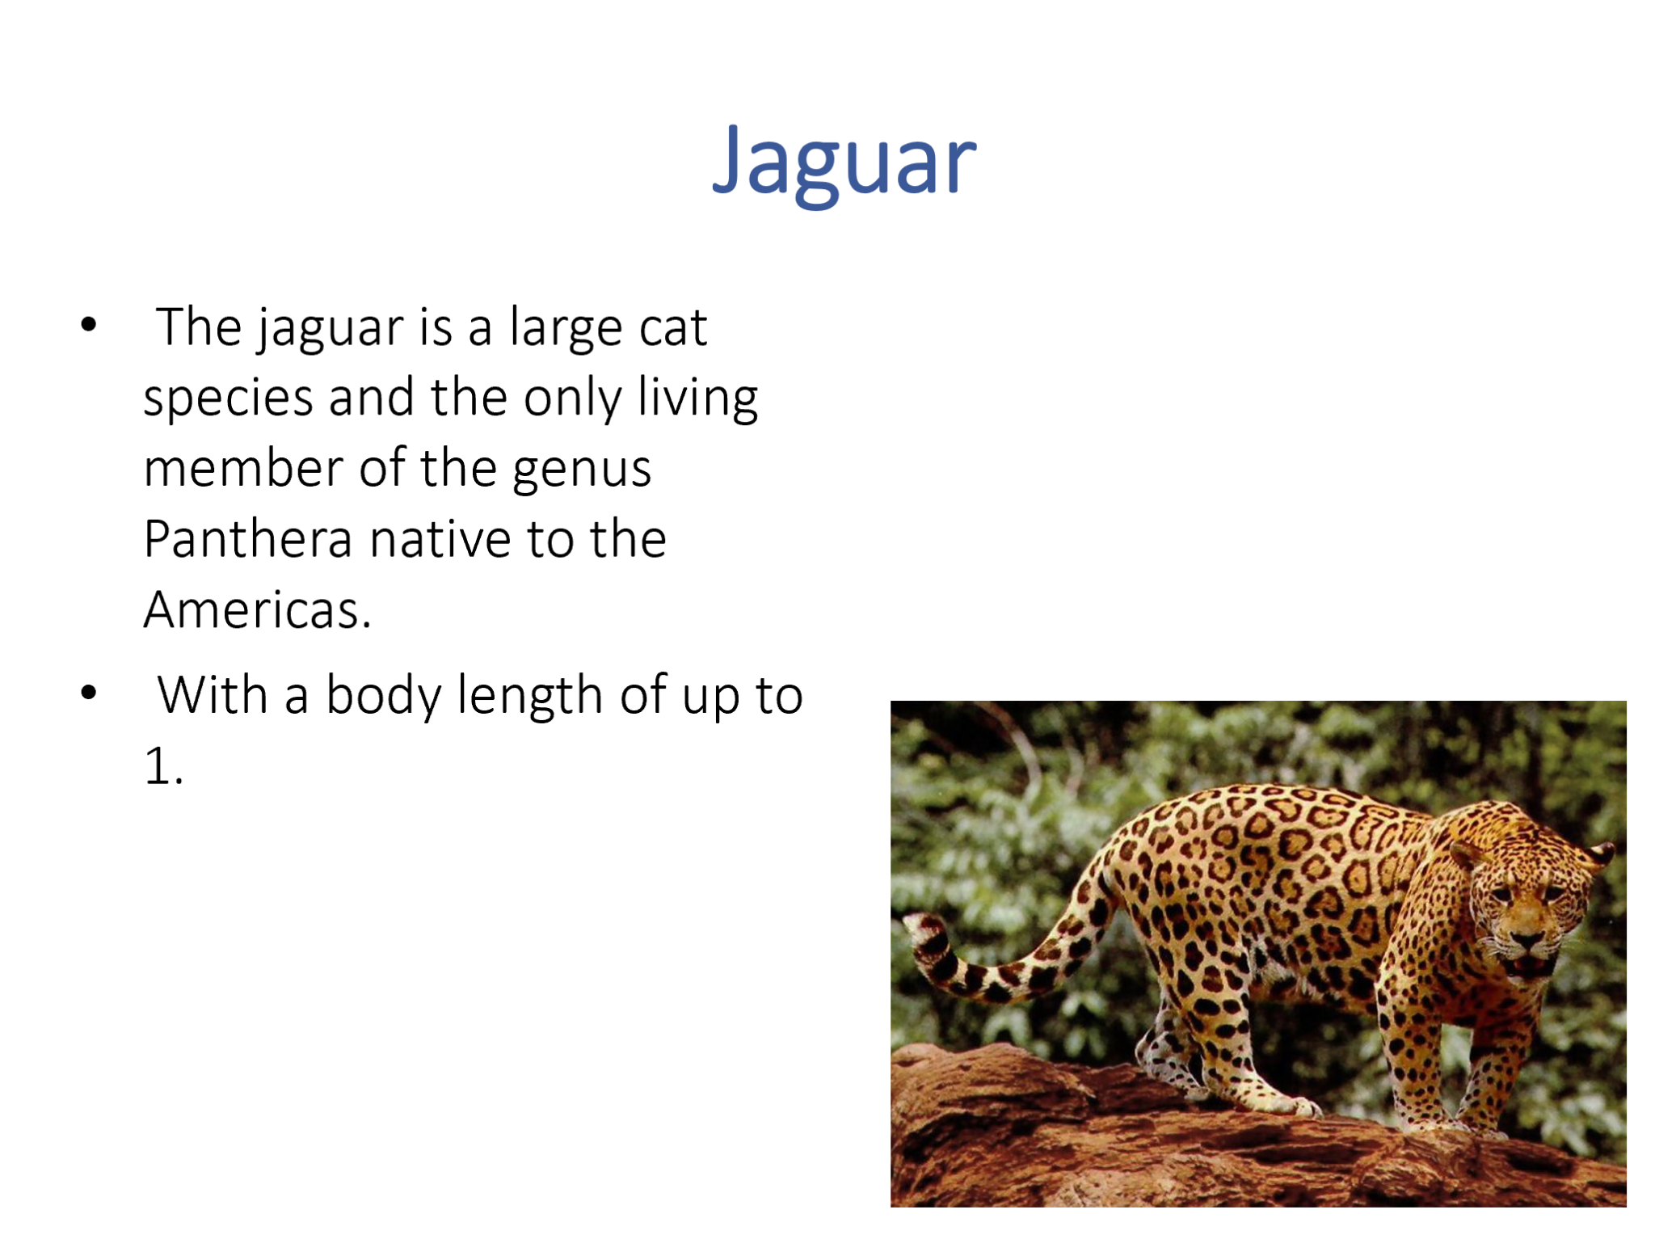

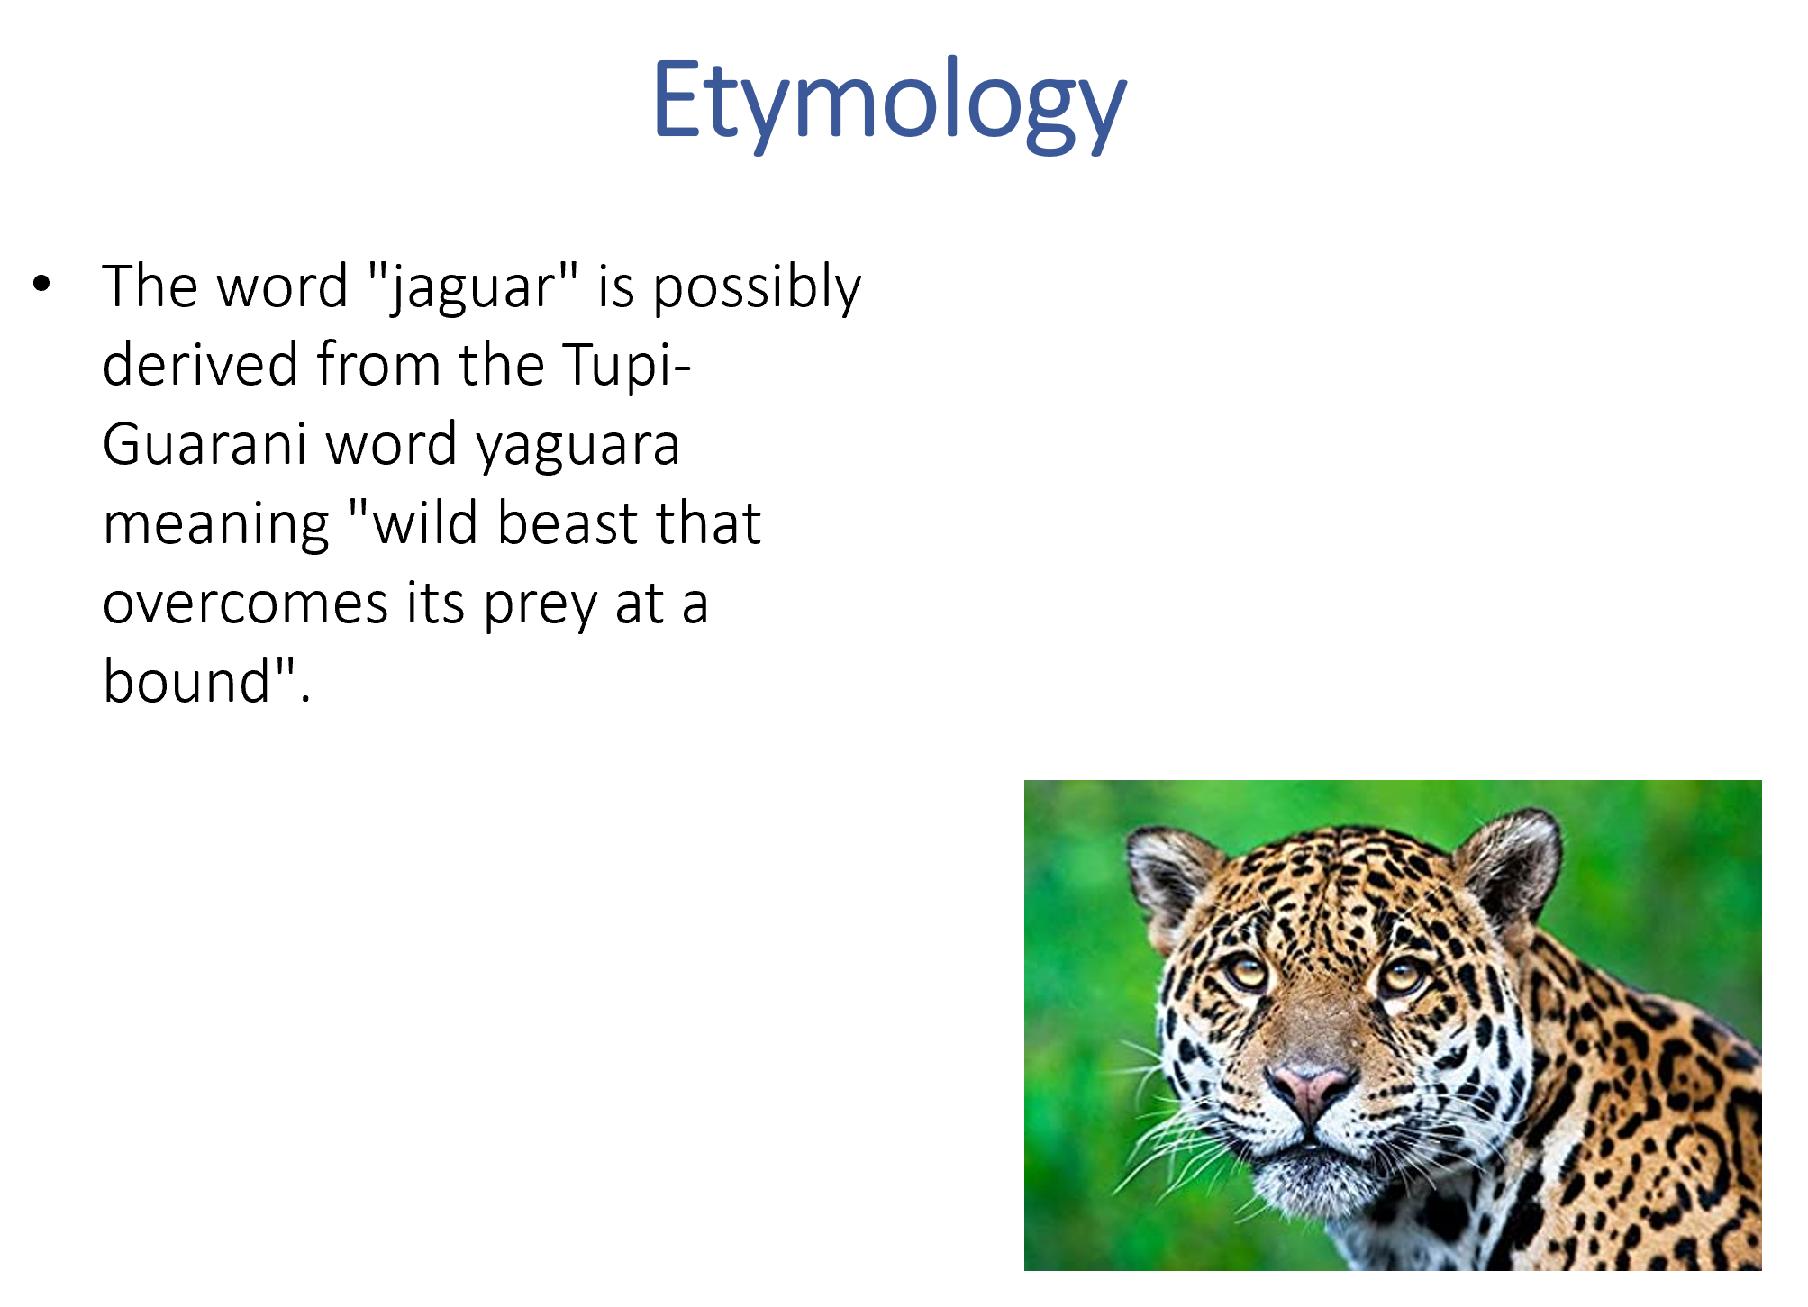
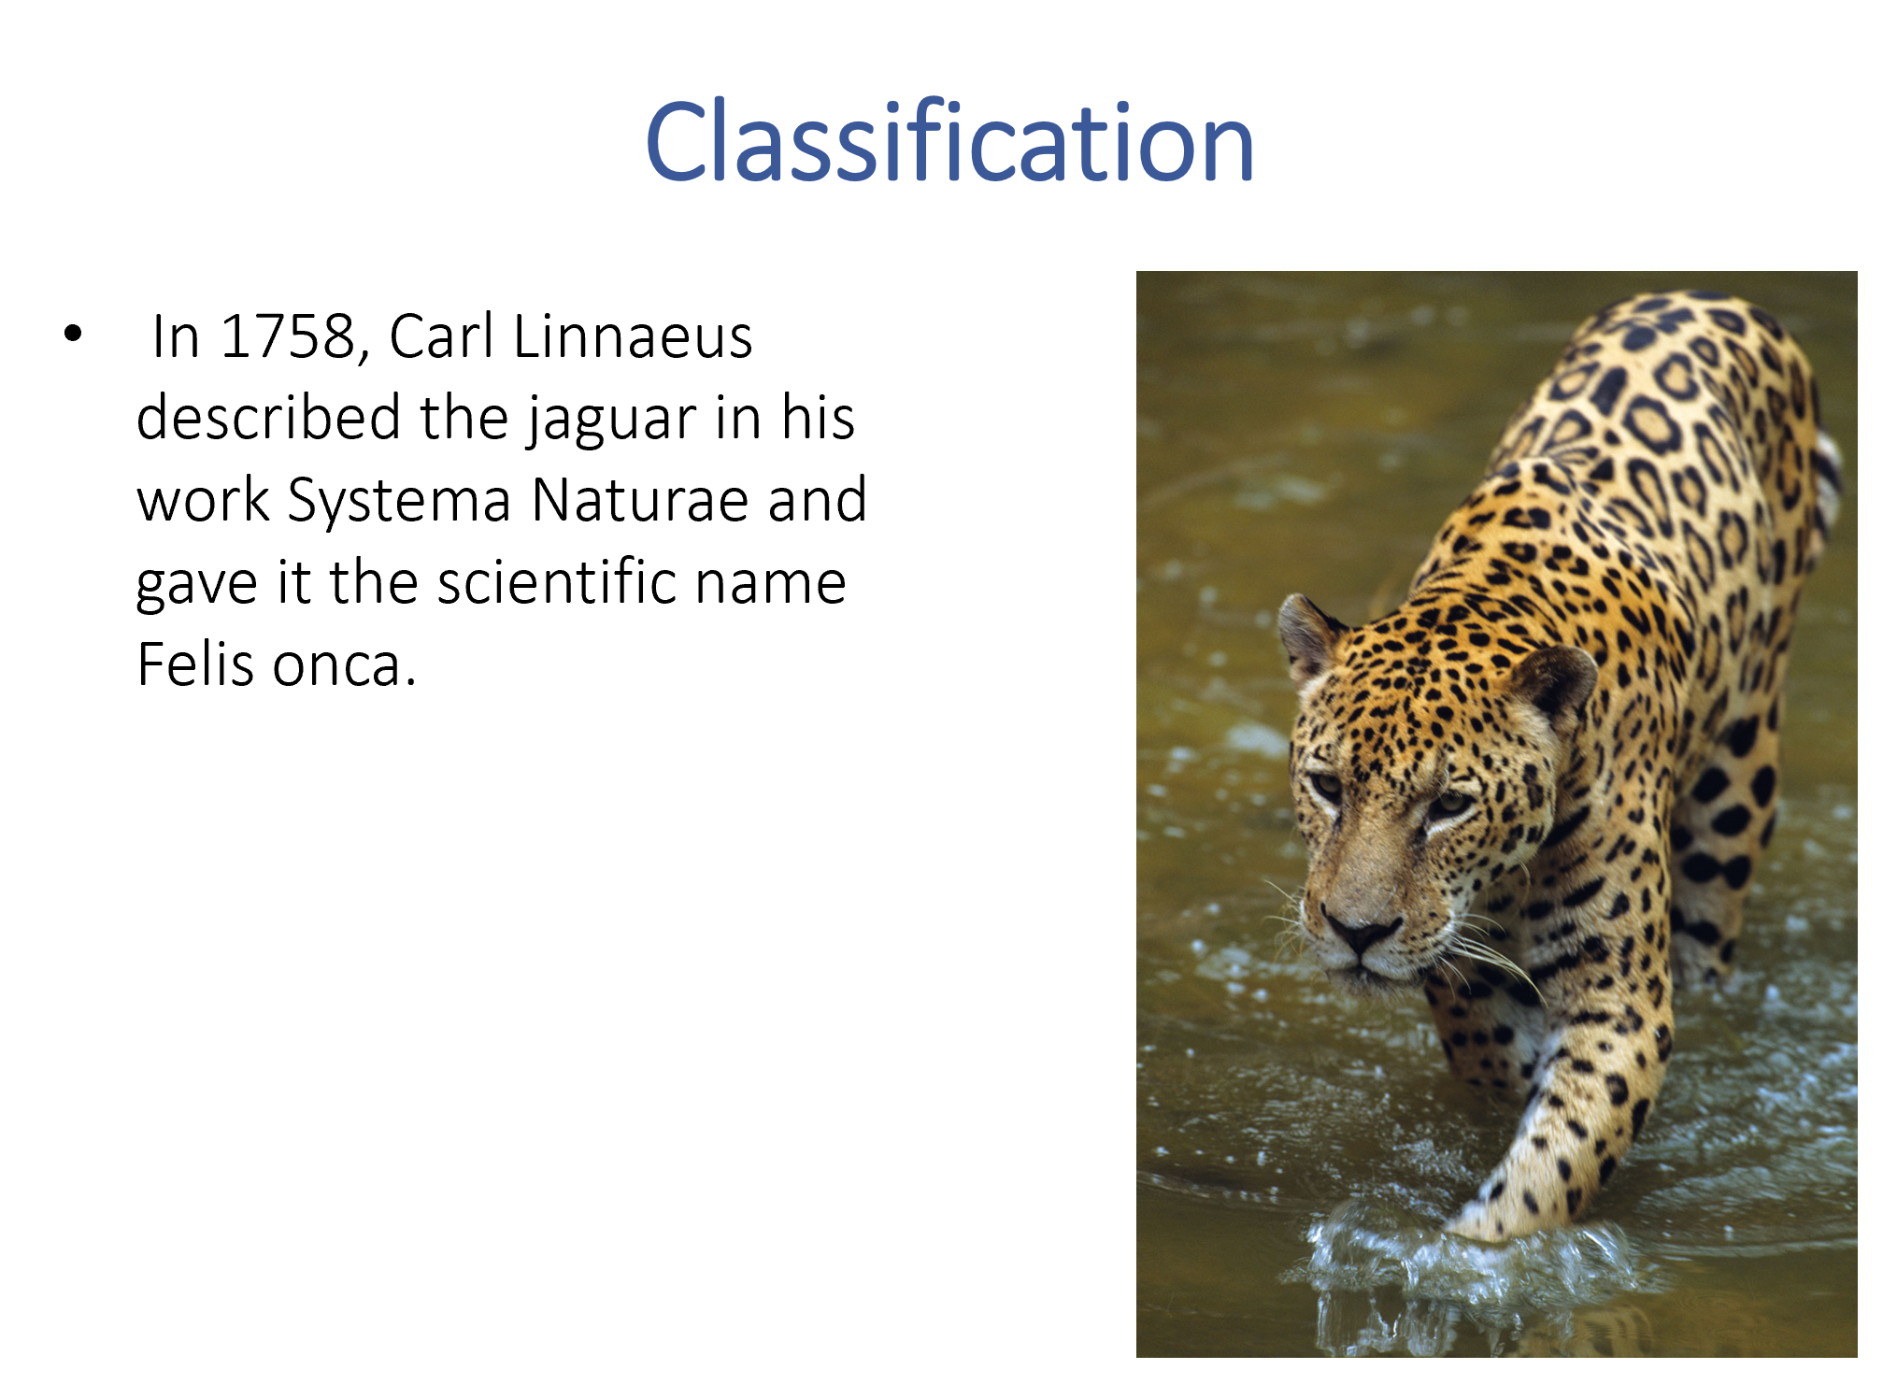
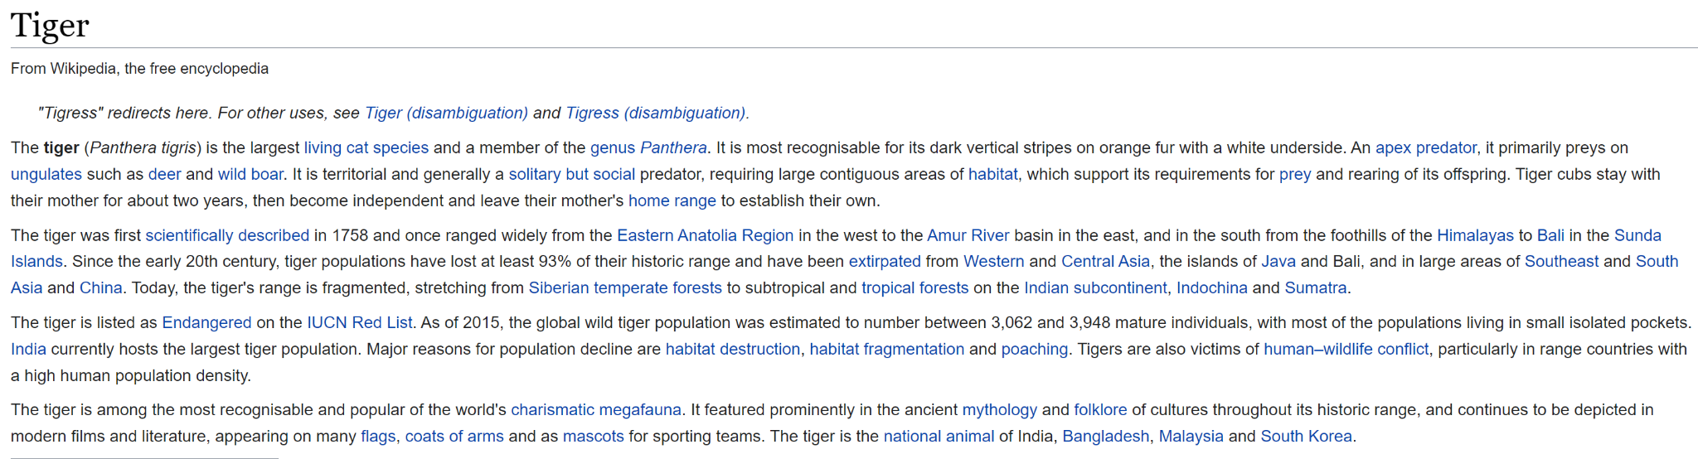
Version 2: Multiple slide PowerPoint file
Keyword is used as input
An API gets Information relating to the keyword from wikipedia
A GPT-3 model summarizes the text to bullet points
Output
Wikipedia API for Text
r
Input
Jaguar

Slide 4
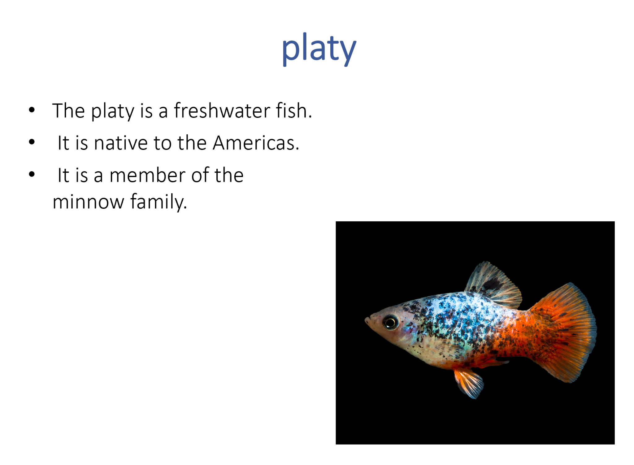
Version 3: PowerPoint file without external source
Goal was to try and let GPT-3 come up with matching text to a given keyword
Used in combination with the image downloader to create a pptx file
Output
Input
platy

Slide 5
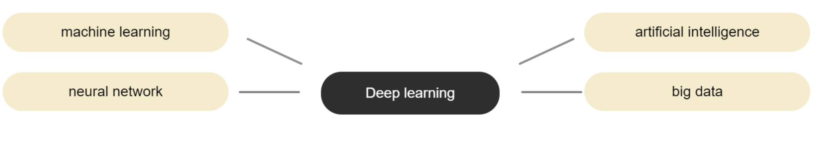
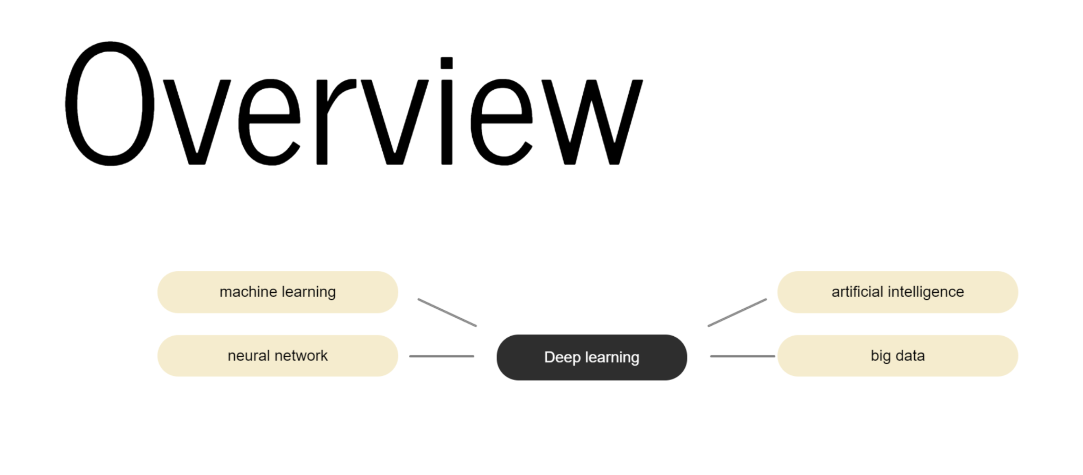
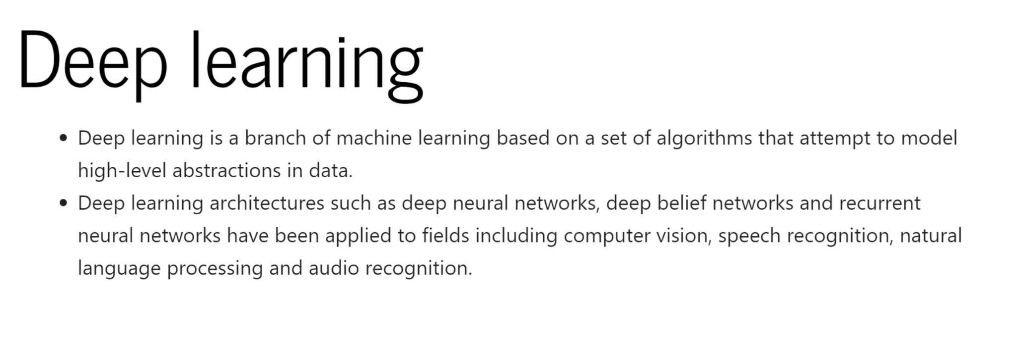
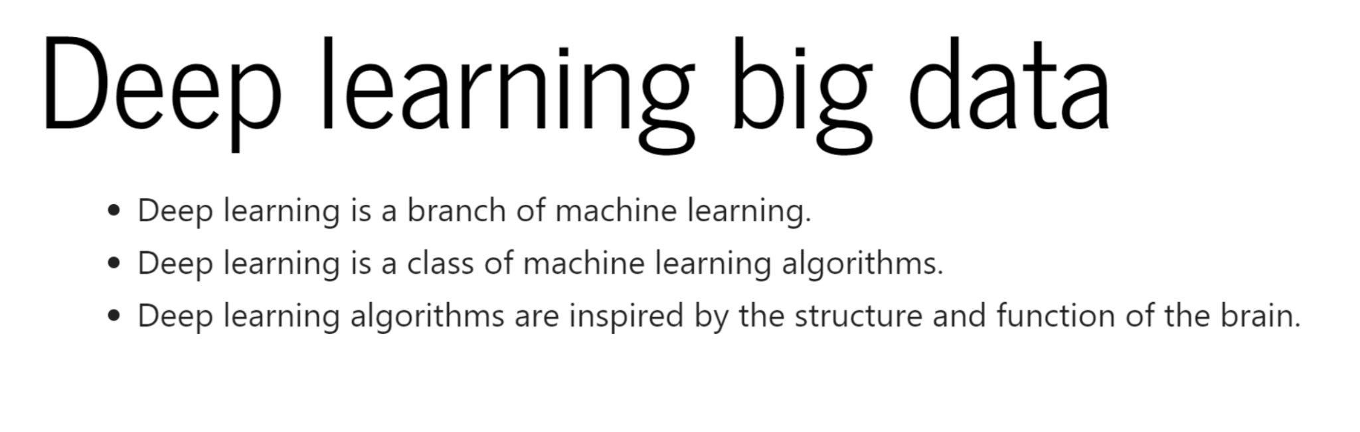
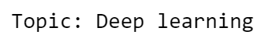
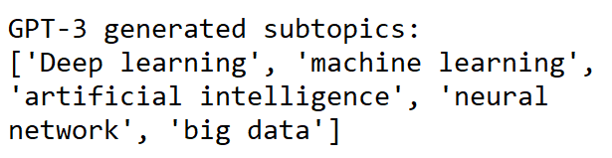
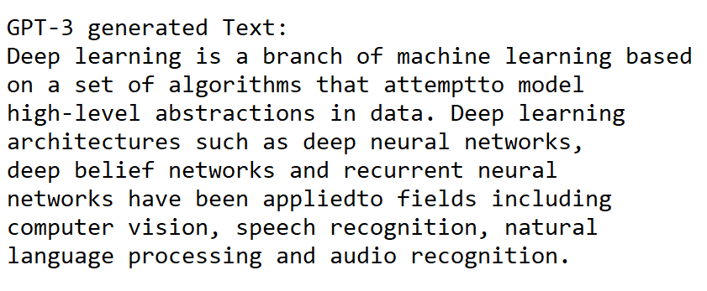
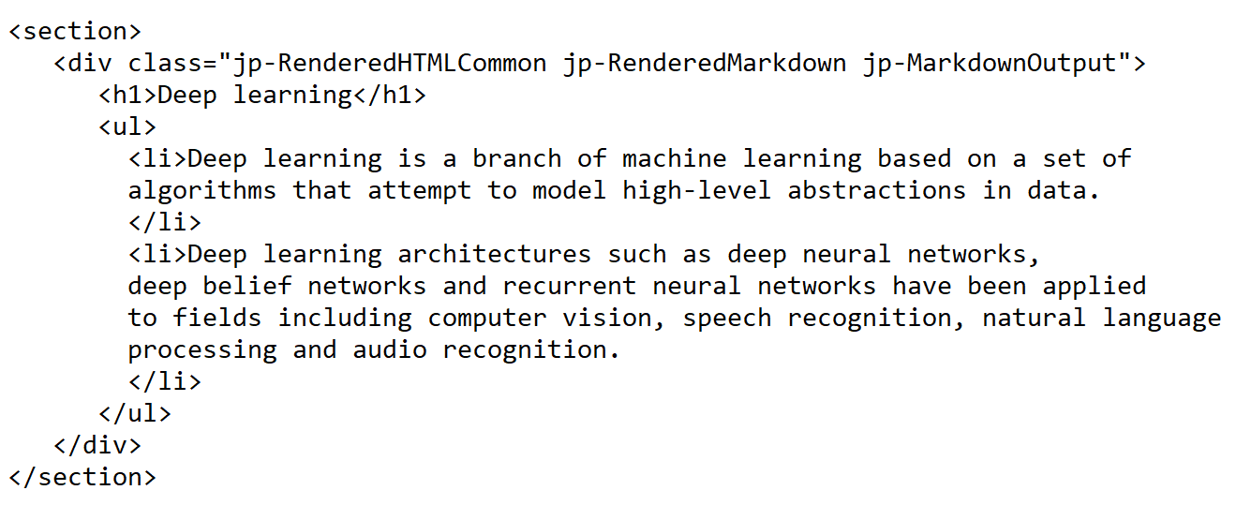
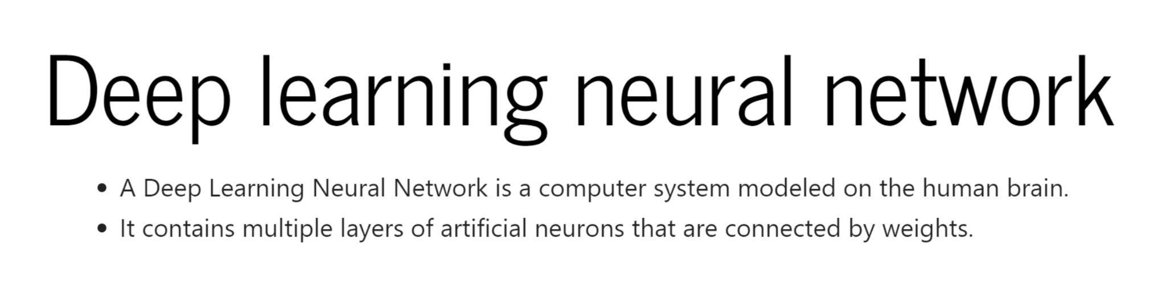
Version 4: HTML Presentation
HTML Presentation
GPT Mindmap HTML generation
Topic Input
GPT Subtopic generation
GPT Text generation
GPT Slide HTML generation

